Slide 1
1/23 Class 2 – Unsupervised Fraud Algorithms
Fraud processes
Finding anomalous records (unsupervised fraud algorithms)
Principal Component Analysis (PCA)
Variables for NY fraud model
Data preparation: cleaning, filling in missing fields
After today you have all the info needed to solve Project 1

Slide 2
Process for Product Applications, Transactions, Claims…
Through
The Door
(TTD)
Credit check,
eligibility
(score, algorithm)
Yes/OK
Fraud check
(score, algorithm)
Yes/OK
Approve
Book new account,
Pay claim or request
Approve transaction
…
No
No
FRAUD EXPERTS,
EXAMINERS
Decline
Manually review
Get external data
Make phone call
Send letter, email
…
Review
Yes/OK
Approve
Outcome generally known
Label as a good or bad
No
Decline
Note: “algorithm” can be rules, linear or logistic regression, or complex ML model
Don’t know truth
(leads to Reject Inference problem)
This process is used for any product that pays money (loans, credit cards, cell phones, insurance claims…)
2

Slide 3
Supervised Vs. Unsupervised Modeling
Unsupervised
Supervised
x₁ x₂ x₃ … x_{n}
x₁ x₂ x₃ … x_{n} y
All you have are independent variables
x₁ x₂ x₃ … x_{n}
x₁ x₂ x₃ … x_{n} y
You also have a dependent variable y
x₁ x₂ x₃ … x_{n}
x₁ x₂ x₃ … x_{n} y
x₁ x₂ x₃ … x_{n}
x₁ x₂ x₃ … x_{n} y
x₁ x₂ x₃ … x_{n}
x₁ x₂ x₃ … x_{n} y
x₁ x₂ x₃ … x_{n}
x₁ x₂ x₃ … x_{n} y
…
…
Find relationships
Find structure
Find anomalies
Build y=f(x) from data examples
Lots of uncertainty
Never really know how well you’ve done
Clarity of goal
Easily see how well you’ve done
In general, we always build supervised models when possible

Slide 4
How to Approach a Fraud Solution
Listen, ask questions, fully understand business goals
Understand the fraud dynamics, as many fraud methods as possible (start thinking about entities and variables)
How will solution be implemented, used, maintained, measured, evaluated?
What data is available, historical?, going forward?, how collected, stored, do you have labels?
Design the problem framework: supervised or unsupervised?, regression or classification?, forensic or real time?, what time scales?, what are the inputs/outputs?, how to structure the data?
Prepare data, build models, evaluate

Slide 5
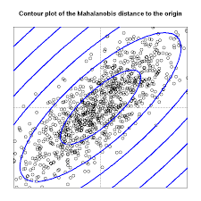
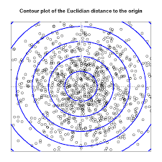
Mahalanobis Distance
Which point is farther from the center, the red or green?
The Mahalanobis distance takes into account the different scales and correlations. It draws equal contours by scaling based on the correlations and different standard deviations. It then measures how many standard deviation contour lines it crosses between points.
X2
X1
The Mahalanobis distance from the center is the same as first transforming to the Principal Component space and then scaling by the eigenvectors, or first PCA then z scaling.

Slide 6
Methods for Unsupervised Models
Unsupervised models are ones where we don’t have labeled data.
Some unsupervised modeling is about finding structure or clusters in the data
But for fraud it’s about finding outliers:
Find the right space (expert variables, as low dimensionality as possible)
Talk to experts, build expert variables
Remove correlations, do linear transformations (e.g. PCA)
For fraud, sometimes clustering/grouping first is important
Two ways to build an unsupervised fraud algorithm:
Method 1: Use a Mahalanobis-like distance:
z scale, PCA, z scale, heuristic function of zscores
Method 2: Use an autoencoder reproduction error
Can use both methods to get two different scores, then combine them

Slide 7
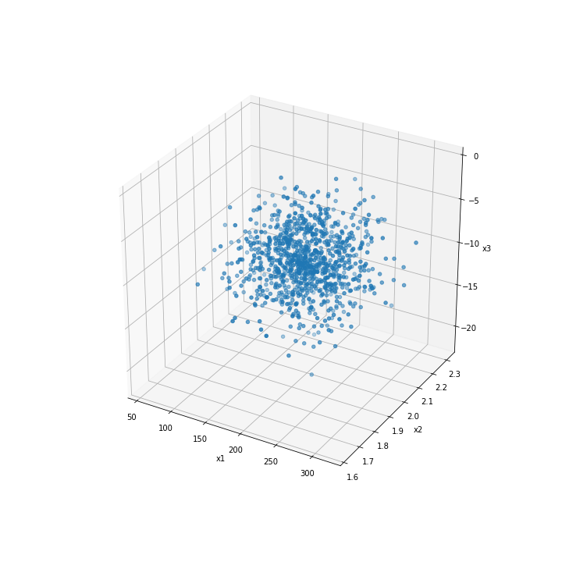

Finding Outliers: First Scale Dimensions
Original data
Dimension mean μ stdev σ
x1
198
40
x2
2
0.1
x3
-9.9
3
Z scale:
Scaled data
Note the different scales and averages
Dimension mean μ stdev σ
z1
0
1
z2
0
1
z3
0
1
After z scaling all dimensions are on the same footing and the data is centered

Slide 8
After Scaling, Finding Outliers is Easy
Scaled data
Dimension mean μ stdev σ
z1
0
1
z2
0
1
z3
0
1
The data is a cloud around the origin with the same scaling for all dimensions
Now a simple measure of “outlierness” is distance from the origin
An anomaly (fraud) score is
Distance from the origin after proper data preparation and scaling
Here’s a general measure for distance from the origin:

Slide 9
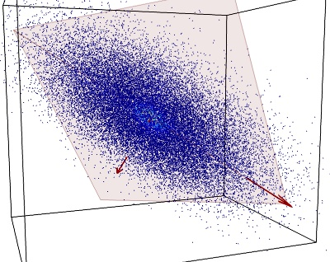
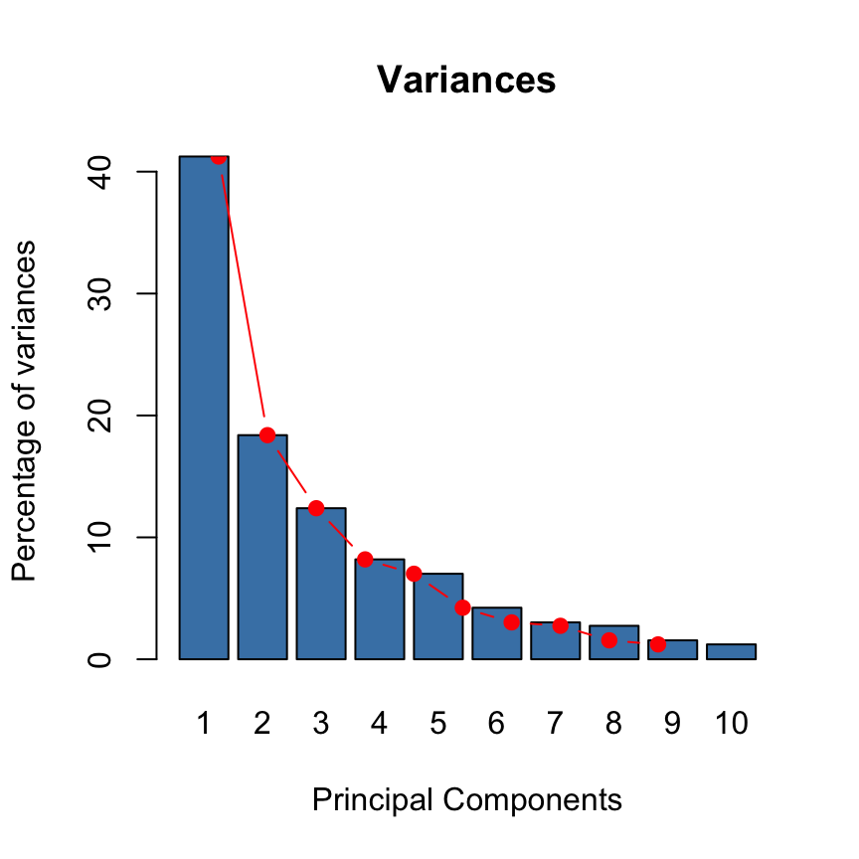
Principal Component Analysis and Regression (PCA, PCR)
PCA finds the dominant directions in the data and rotates the coordinate system along these directions
The PC’s are orthogonal, and ordered by the variance (spread) in their direction
Each PC is a rotated axis and is thus a linear combination of the original variables
The magnitude of the PC’s are the eigenvalues of the PC’s
The eigenvalues are proportional to the variance in that PC’s direction
PC2
PC1
Scree plot
One can look at the decaying of the eigenvalues and select a subset of the PC’s as a subspace to work in. One can then regress in this PC subspace. That’s PCR.

Slide 10
Remember That Rotation is a Linear Transformation of Coordinates
x₂
x₂’
x₂
x₁
x₁
x₁’
x₂’
x₁’
x₂
x₂
x₁
x₁
Introduce a new coordinate system x₁’, x₂’ that is a rotation through angle θ.
The original points (x₁,x₂) can be written in terms of the new coordinates through a simple linear transformation:
x₁’ = x₁ cos θ + x₂ sin θ
x₂’ = − x₁ sin θ + x₂ cos θ

Slide 11
Principal Component Analysis: Find the PCs
x₁’
PC1
Each PC is a rotated axis and is thus a linear combination of the original variables
The length of the PCs are proportional to the data variance in that PC’s direction
The PCs are sorted by magnitude (size), shown in a “scree plot”
x₂’
x₂
PC2
x₁
Scree plot
and are just numbers (constants)
In general,
…

Slide 12
Principal Component Analysis: Rotate the Coordinates
After calculating all the PCs we rewrite the original data records in terms of the PCs
That is, we introduce this new rotated coordinate system (the PCs) and write the data in terms of this rotated coordinate system
Note that the PC algorithm is all automated as a very fast statistical package that can be called in R, Python, SAS, Matlab…
x₁ x₂ x₃ …. x_{n}
x₁ x₂ x₃ …. x_{n}
x₁ x₂ x₃ …. x_{n}
…
x₁ x₂ x₃ …. x_{n}
PC₁ PC₂ PC₃ …. PC_{n}
PC₁ PC₂ PC₃ …. PC_{n}
PC₁ PC₂ PC₃ …. PC_{n}
…
PC₁ PC₂ PC₃ …. PC_{n}
Original independent variables
(n by m)
Independent variables written in terms of the new rotated PC coordinate system
(still n by m)

Slide 13
Principal Component Analysis: Dimensionality Reduction
The PCs are sorted by magnitude (size), shown in the scree plot
We examine this scree plot and decide how many PCs we want to keep
Typically we keep just the first few, trying to account for ~80 to 90% of the total variance
We throw away the higher PCs and our data matrix has been reduced in dimension
We still have all the records but we’ve reduced the dimensions from n to just a few
PC₁ PC₂ PC₃ PC₄ PC₅ PC₆ PC₇ PC₈ PC₉ … PC_{n}
PC₁ PC₂ PC₃ PC₄ PC₅ PC₆ PC₇ PC₈ PC₉ … PC_{n}
PC₁ PC₂ PC₃ PC₄ PC₅ PC₆ PC₇ PC₈ PC₉ … PC_{n}
…
PC₁ PC₂ PC₃ PC₄ PC₅ PC₆ PC₇ PC₈ PC₉ … PC_{n}
Scree plot
Scree plot
…
PCA is an unsupervised linear method that
reduces dimensions and removes linear correlations

Slide 14
Principal Component Regression
Now that we have reduced the dimensionality we can do a regression in this new PC space
A linear regression in the PC space is called a Principal Component Regression (PCR)
PC₁ PC₂ PC₃ PC₄ PC₅ PC₆ PC₇ PC₈ y
PC₁ PC₂ PC₃ PC₄ PC₅ PC₆ PC₇ PC₈ y
PC₁ PC₂ PC₃ PC₄ PC₅ PC₆ PC₇ PC₈ y
…
PC₁ PC₂ PC₃ PC₄ PC₅ PC₆ PC₇ PC₈ y

Slide 15
Unsupervised Fraud Algorithms Look for Unusual Records. Method 1: Heuristic Function of the zscores
SSN
Name
Address
Application date/time
Phone number
Date of birth
Email address
IP address
Device ID
The Mahalonobis-like distance concept looks explicitly for outliers after taking into account scaling and correlations
Rather than use Mahalanobis distance explicitly we do our own version that allows us more control
Build all your expert variables
Z scale to get all the dimensions scaled similarly
Do a PCA on these. Throw away all but the top PCs
Z scale again if you want all the remaining PCs to be equally important. If not, then don’t do this second z scale.
Now the zscores tell explicitly the “outlierness” of each variable

Slide 16
Unsupervised Fraud Algorithms Method 1: Heuristic Function of the zscores
Start with as many expert variables as possible. They will have different scales, lots of correlation.
Z scale to center the data and get all the scales the same
PCA removes the correlations, allows dimensionality reduction, leaving the main information
Z scaling again makes all the retained PCs equally important
These new, reduced dimensions are relatively uncorrelated, similarly scaled, and the data points are centered (mean is zero)
Now on each record the value of each variable explicitly shows how unusual that record is in that dimension. We call all these z scaled variables zscores.
We want to add up these zscores on each record, without letting them cancel each other out
A good fraud score is
SSN
Name
Address
Application date/time
Phone number
Date of birth
Email address
IP address
Device ID

Slide 17
Unsupervised Fraud Algorithms Look for Unusual Records. Method 2: Autoencoder
An autoencoder is a model trained to output the original vector input
After the model is trained, the difference between the original input vector and the model output vector is the fraud score for that record
z₁
z₁’
z₂
z₂’
Output record is close to the original input record
Original input record
z₃
z₃’
z₄
z₄’
z₅
Autoencoder
model
z₅’

Slide 18
Unsupervised Fraud Algorithms Method 2: Autoencoder
First get the data well prepared (z scale, PCA, reduce dimensions, z scale again). We do this the same way for both Methods 1 and 2.
Train an autoencoder on the entire data set. The model will learn to reproduce the data records as well as possible, and will learn the nature of the bulk of the data.
The records that aren’t reproduced well are unusual records, which is what we’re looking for.
Therefore a measure of the reproduction error is a measure of unusualness for that record, and is thus a fraud score:
Note an autoencoder is nonlinear, whereas Method 1 is linear.
SSN
Name
Address
Application date/time
Phone number
Date of birth
Email address
IP address
Device ID

Slide 19
Break

Slide 20
Project 1: Find Anomalies in NY Property Data
You’ve just been hired by the city of NY. They think there might be some property tax fraud going on in their city, but they’re not sure.
They have no idea how to discover this.
They want you to build an algorithmic system that can look through their ~1 million property records to find potential tax fraud.
The kind of fraud they’re looking for is people underpaying tax or otherwise misrepresenting their property characteristics.

Slide 21
NY Property Data Investigation
We’ll be looking for anomalies in the data (strange, unusual field values, unusual records)
Some possible modes of property fraud
Assessed value too low (too high?)
Person claiming an exemption for more than one property (requires linking by person)
Claiming exemption on rental property (simple rule?)
We’ll only consider the first of these modes

Slide 22
How to Approach the Problem
Think about how you would do it if you could do it by hand. What would you do?
What if you only had 20 records? How would you solve the problem?

Slide 23
Project 1 Variables
Create these 3 sizes:
lotarea = LTFRONT * LTDEPTH
bldarea = BLDFRONT * BLDDEPTH
bldvol = bldarea * STORIES
Calculate 9 variables, each of the 3 values normalized by each of these 3 sizes (3 * 3 = 9 variables)
Create the grouped averages of these 9 variables, grouped by
zip5, zip3, taxclass, borough, all
Divide each of the 9 core variables by the 5 scale factors from these groupings
This makes 9 * 5 = 45 variables
Add any additional variables you can think of that make sense, if you want.

Slide 24
Project 1 Variables
V₁ = FULLVAL
V₂ = AVLAND
V₃ = AVTOT
S₁ = LTFRONT * LTDEPTH
S₂ = BLDFRONT * BLDDEPTH
S₃ = S₂ * STORIES
For on each record append 9 ratios:
Separately group records by these 5 groups: zip5, zip3, TAXCLASS, borough, all (no group)
For each group g, calculate , the average of each r_{i} for each group g
For each record calculate and append 45 variables:
g = 1, …, 5

Slide 25
Philosophy for Filling in Missing Field Values
We want our algorithms to be able to score all records, even records with some missing fields
So we want a process for filling in missing fields
Since we are “making up” these filled-in values we want them to be as “normal”/appropriate as possible
We certainly don’t want these filled-in values to set off our unusualness alarms. We want them to be kind of neutral.
So we try to fill in missing fields with the most typical value for that field for that record
SSN
Name
Address
Application date/time
Phone number
Date of birth
Email address
IP address
Device ID

Slide 26
How Would You Fill In Missing Fields?
Let’s say you need to fill in a few missing fields from this data set
Average of all heights?
OK, but can do better
Average of all heights of the males?
Better…
How about average of all heights of the males in a particular weight range?
Even better
?

Slide 27
How to Handle Missing Field Values
Keep in mind that “missing” might be an important piece of information, but for this problem we’re not going to use that information
Should we ignore the records that have a missing field? – not a good approach…
Better to replace the missing field value with something reasonable:
Build a model to predict the missing value given the other field values (usually too complicated)
Use the average or most common value of that field over all records (note – this is itself a simple model)
Use the average or most common value of that field over a relevant subset of records:
Select one or more other fields that you think are important in determining the missing field
Group the selected field(s) into categories
Replace the missing field with the average or most common value for its appropriate group
Given data:
Record
# stories
sq feet
Zip
value
Fill in with
Average value across all records, or better
Average value for records in zip 22042, or
Average value for all records with # stories = 3, or
Average value for all records in zip 22042 and # stories = 3
…
Fill in with
Average # stories across all records, or better
Average # stories for records in zip 22041 only
…
1
2
3
4
5
6
7
8
9
2
1
3
3
2
NaN
4
3
2
294
495
3847
9278
129
948
847
1029
947
22041
22043
22042
22041
22052
22041
22043
22052
22051
1032
539
NaN
4837
462
583
2094
7632
489

Slide 28
Filling In Missing Fields
We only need to fill in missing values for fields that will be usd to create variables
For our NY property data we will need to fill in missing values for these fields: FULLVAL, AVLAND, AVTOT, ZIP, STORIES, LTFRONT, LTDEPTH, BLDFRONT, BLDDEPTH
For the three values, when they are missing we want to fill in with innocuous values that won’t set off a fraud alarm. Use the field averages, and you can group by any entity you think makes sense.
For the other fields needed for scaling (LTFRONT, LTDEPTH, STORIES, BLDFRONT, BLDDEPTH), fill in with values that make sense. You can use whatever logic you want, for example:
If LTFRONT=LTDEPTH=0, set them to (30, 100)
If BLDFRONT=BLDDEPTH=0, set them to (20, 40)
If STORIES=0, set it to average stories by zip code, borough, TAXCLASS, or some other entity.

Slide 29
Homework 2 – How to Fill in Missing Fields
Describe how you will fill in the necessary missing fields in the NY data (FULLVAL, AVLAND, AVTOT, LTFRONT, LTDEPTH, BLDFRONT, BLDDEPTH, ZIP, STORIES).
You can list several that will use the same logic, for example:
For FULLVAL, AVLAND, AVTOT: Aggregate by ZIP and TAXCLASS, use the median value of that group. If fewer than 5 records in that group, aggregate by TAXCLASS only.
Describe logic for all these 9 fields that need to be filled in.

